Slide 1
UNIT FIVE- Part One

Slide 2
People management
People management, also known as human resource management (HRM), encompasses the tasks of recruitment, management, and providing ongoing support and direction for the employees of an organization.

Slide 3
The diversity advantage
Diversity is linked with competitive advantage. It brings to problem‐solving and strategy formulation an array of talents, perspectives, experiences and worldviews that broaden any organisation’s repertoire of skills and capabilities. That’s one side of the diversity story — finding the best talent available. The other side of the story is tapping it — finding ways to allow diversity to work its advantages to help create high‐performing organisations

Slide 4
Employment discrimination
Discrimination involves ‘making a distinction between individuals or groups so as to advantage some and disadvantage others’. Employers specifically and managers generally must take care in their HRM practices not to discriminate between people on the basis of characteristics such as age, disability, marital status, ethnicity, family responsibilities, social origin.

Slide 5
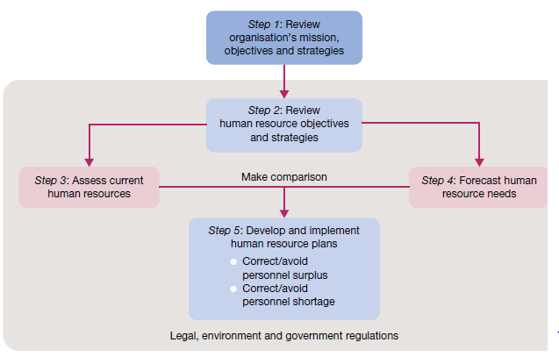

Slide 6
The foundations for HR planning are set by job analysis — the orderly study of job facts to determine just what is done, when, where, how, why, and by whom in existing or potential new jobs. The job analysis provides useful information that can then be used to write and/or update a job description. This is a written statement of job duties and responsibilities. The information in a job analysis can also be used to create a job specification that lists the qualifications — such as education, previous experience and skill requirements — needed by any person hired for or placed in a given job.

Slide 7
External recruitment, in which job candidates are sought from outside the hiring organisation. Specialist websites such as naukri (www.naukri.com), newspapers, employment agencies, universities, personal contacts, walk‐ins, employee referrals and even people in competing organisations are all sources of external recruits. Competition is especially tough in the very tight labour markets characteristic of the contemporary economy

Slide 8
Internal recruitment seeks applicants from inside the organisation. Most organisations have a procedure for announcing vacancies through newsletters, electronic bulletin boards and the like. They also rely on managers to recommend subordinates as candidates for advancement. Internal recruitment creates opportunities for long‐term career paths.

Slide 9
